Slide 1

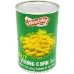
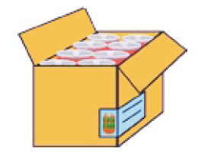
Simple Pack – Non Inner
Step 1
Create
Regular Item
Step 2
Create
Simple Pack
(TPND)
Each
Case
Item Level I
Canned Corn
UCC 12
Store SOH is
held at the
Each / TPNB
level
Item Level 2
Canned Corn
ORIN
Level 1 – Case
- (SP)ORIN
- Orderable
WH SOH is
Held at the
simple pack / TPND
level
Item Level 3
EAN / UCC
Level 2 – Case
- OCC (EAN 14)

Slide 2
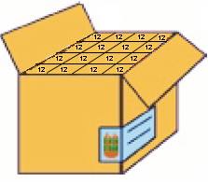
Inner
Simple Pack of 12 Eaches
Inner = Qty 1 (always 1)
Case = Qty 16 (number of inners)
Unit Cost = $12 (each cost * simple pack qty)
Case Cost = $192
Step 1
Create
Regular Item
Step 2
Create
Simple Pack
Each
Case w/Inners
Item Level I
Canned Corn
UCC 12
Store SOH is
held at the
Each / TPNB
Item Level 2
Canned Corn
ORIN
Item Level = 1
Transaction Level = 1
ORIN
Inner Pack
Case of 192 Eaches
Inner = Qty 12
Case = Qty 192
Unit Cost = $1
Case Cost = $192
Item Level 3
EAN / UCC
WH SOH is
Held at the
simple pack / TPND
Item Level = 2
Transaction Level = 1
??? TBD ???
Outer Case Code

